Slide 1
VP260 Recitation Class 7
by Li Chunchao
2016/11/7

Slide 2
Short Review

Slide 3

Magnetic Structure of Solids
magnetic dipole moments
materials with spontaneous magnetic order
materials without spontaneous magnetic order

Slide 4
Sources of magnetic field
law of Biot and Savart
magnetic field of a straight current-carrying conductor
Ampere's law
toroidal solenoid

Slide 5
Solving Problems

Slide 6
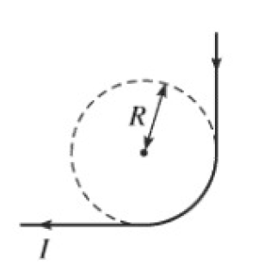
Law of Biot and Savart
A conductor shaped as shown in the figure carries constant current I. Find the magnetic field in the center of the circle.

Slide 7
Law of Biot and Savart
A conical surface (x^2 + y^2 = z^2, 0<z<h) charged uniformly with surface density of charge σ rotates about it axis of symmetry with constant angular velocity ω. Find the magnetic field in the
origin.

Slide 8
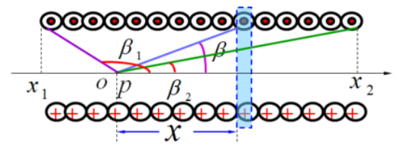
Law of Biot and Savart
If there is a not infinite long solenoid, the left side is β1 and the right side is β2, find the magnetic field at that point.

Slide 9
Ampere's law
If there is a coaxial-cable, I is uniformly distribute in the 0<r<R, -I on r=R.
Find the magnetic field in the space.

